Slide 1
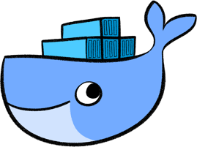
Docker. Docker registry

Slide 2

Проблематика
передача продукта клиенту;
тиражируемость;
переиспользуемость;
ограничение ресурсов;
изолированность;
безопасность.

Slide 3
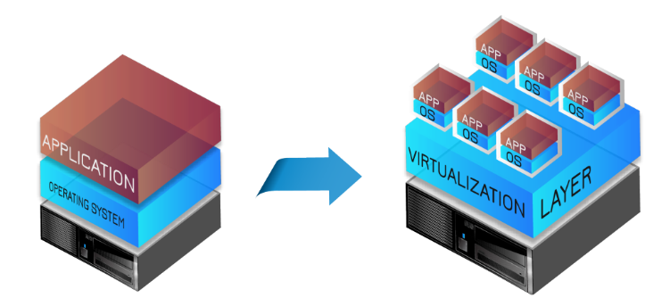
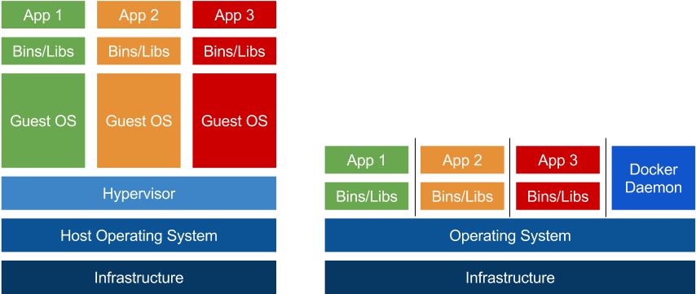
Пути решения: виртуальные машины
Traditional Architecture
Virtual Architecture

Slide 4
Плюсы/минусы виртуальных машин
Плюсы:
запуск различных операционных систем;
полная изолированность (защита о вредоносного ПО);
возможность удобного создания снимков системы и их восстановления.
Минусы:
большой размер инстанса;
высокие затраты ресурсов;
скорость развертывания;
отсутствие прозрачного конфигурирования;
сложность виртуализацию аппаратного обеспечения.

Slide 5
Пути решения: контейнеризация

Slide 6
Плюсы/минусы контейнеризации
Плюсы:
виртуализация на уровне ОС;
работают как отдельные процессы основной ОС;
требует столько ресурсов, сколько нужно, максимум можно ограничить;
скорость развертывания;
занимаемый размер;
удобный способ создания своих контейнеров.
Минусы:
невозможность запустить другие ОС;
работает в рамках ядра ОС (возможны проблемы с безопасностью)
нет удобного механизма создания снимков состояния.

Slide 7
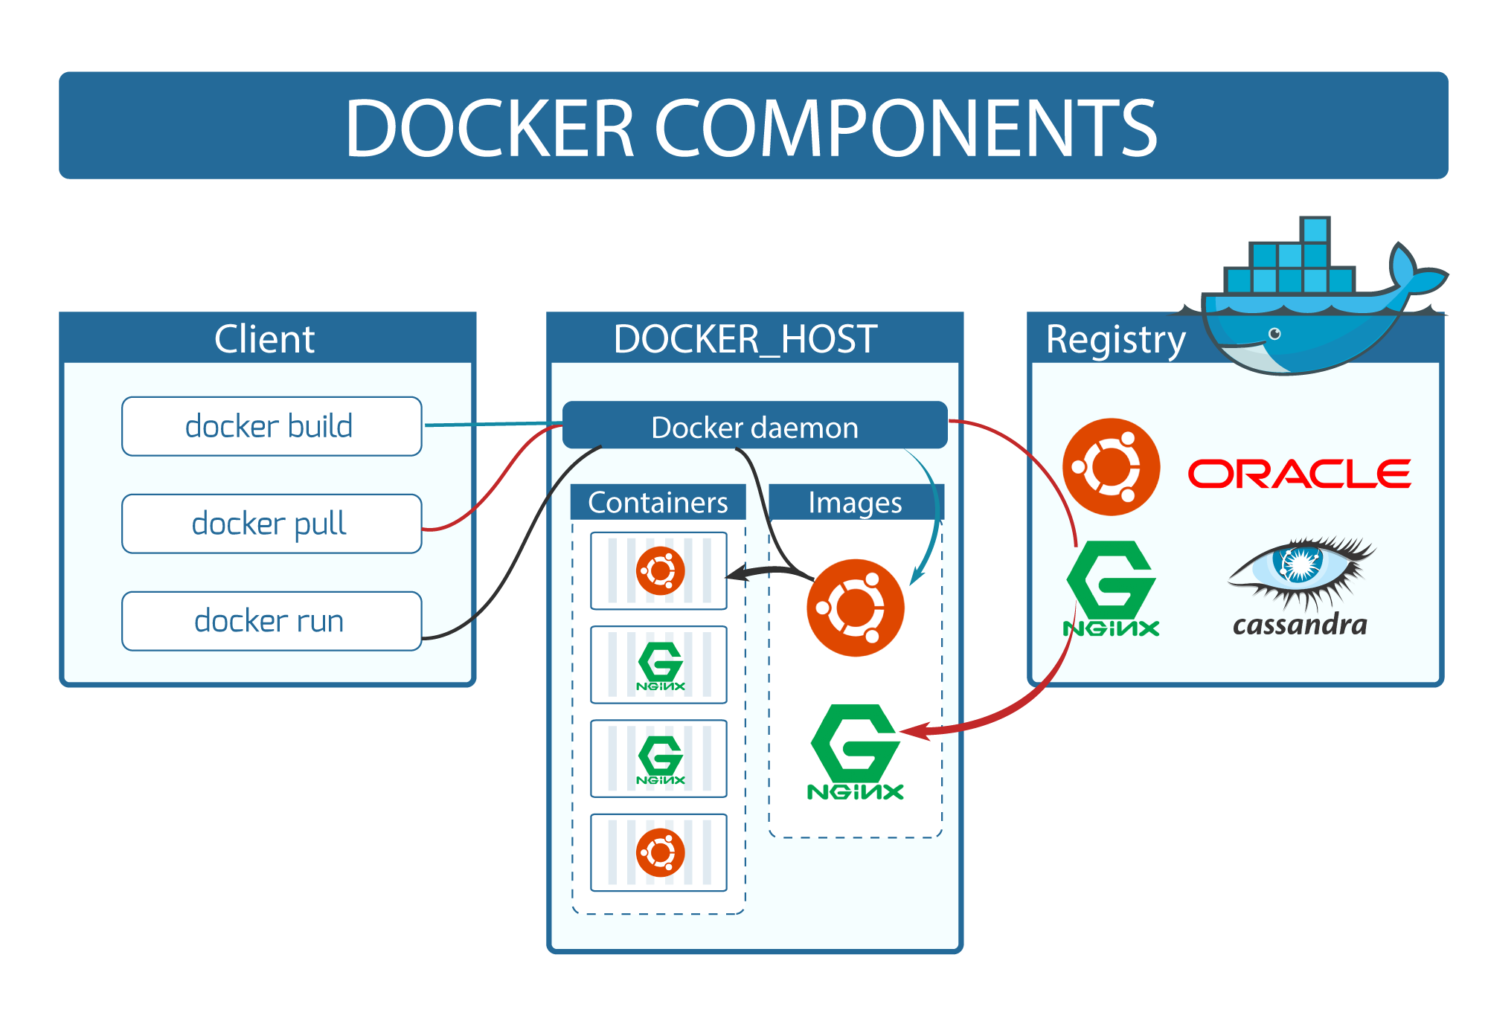

Slide 8
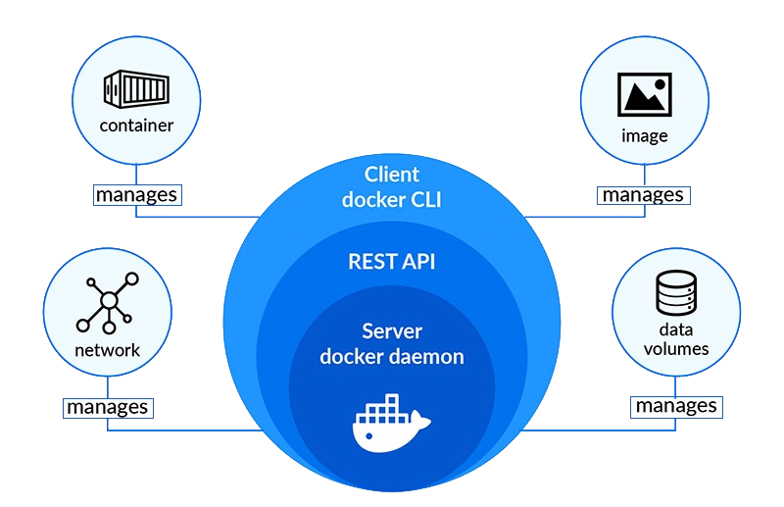
Основные компоненты Docker

Slide 9
Основные понятия
Docker images are the basis of containers. An Image is an ordered collection of root filesystem changes and the corresponding execution parameters for use within a container runtime. An image typically contains a union of layered filesystems stacked on top of each other. An image does not have state and it never changes.
A container is a runtime instance of a docker image.

Slide 10
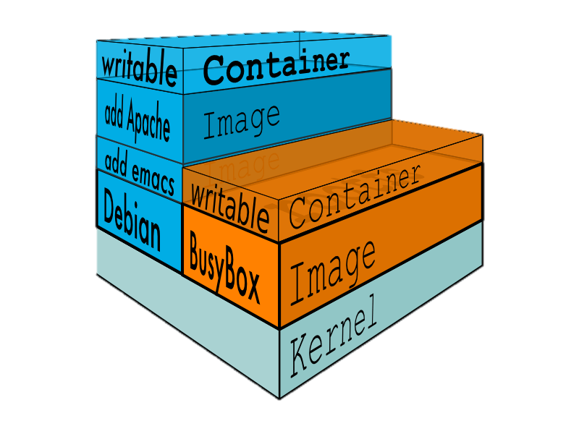
Layers
In an image, a layer is modification to the image, represented by an instruction in the Dockerfile. Layers are applied in sequence to the base image to create the final image. When an image is updated or rebuilt, only layers that change need to be updated, and unchanged layers are cached locally. This is part of why Docker images are so fast and lightweight. The sizes of each layer add up to equal the size of the final image.

Slide 11
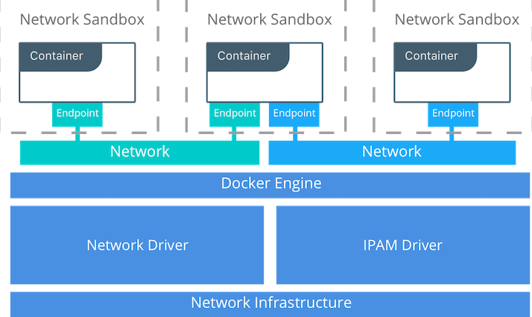
Network
Docker has 3 different types of networks:
– network “bridge” – Default Docker virtual network which is NAT’ed behind the Host IP
– network “host” – It gains performance by skipping virtual networks but sacrifices security of container model
– network “none” – removes eth0 and only leaves you with localhost interface in container

Slide 12
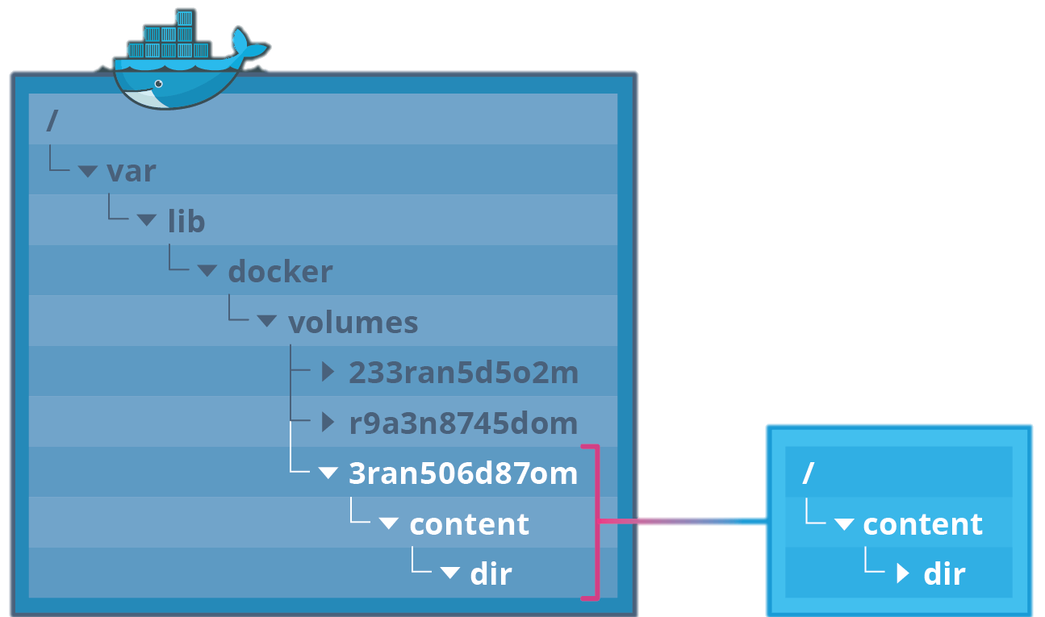
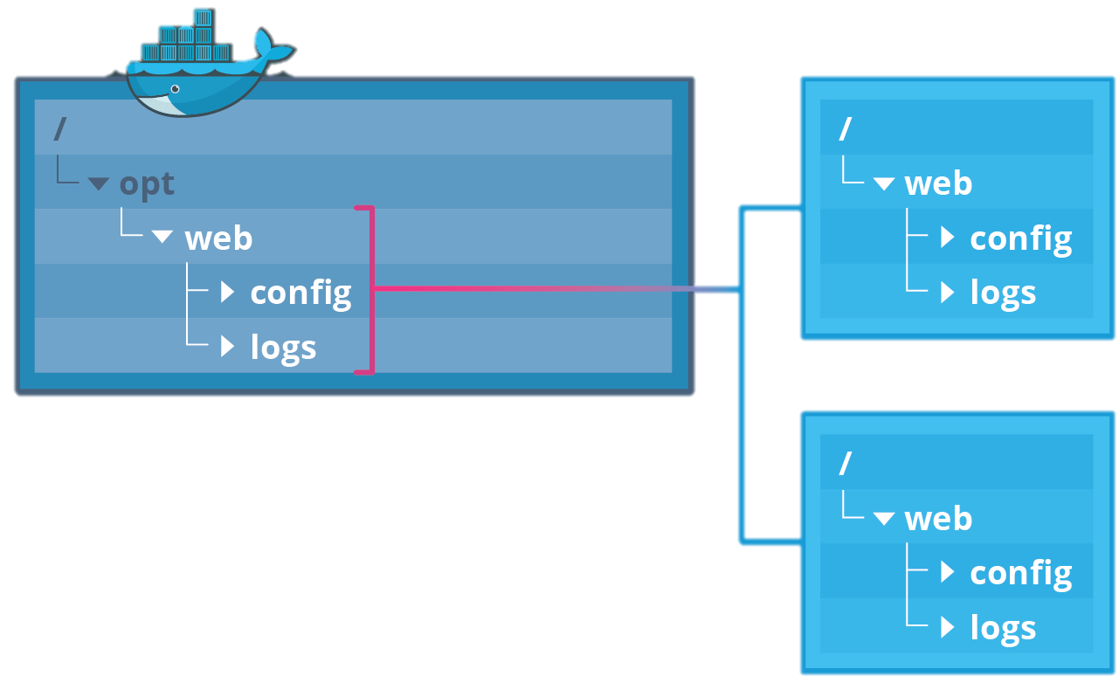
Volumes
A volume is a specially-designated directory within one or more containers that bypasses the Union File System. Volumes are designed to persist data, independent of the container’s life cycle.
Implicit
Explicit

Slide 13
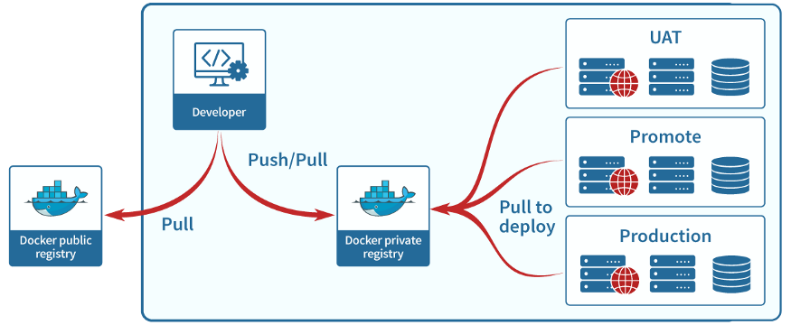
Docker Registry
A Registry is a hosted service containing repositories of images which responds to the Registry API.
The default registry can be accessed using a browser at Docker Hub or using the docker search command.

Slide 14
Основные элементы Docker Registry
Examples of image names:
ubuntu:16.04;
ubuntu:latest.
A repository is a set of Docker images. A repository can be shared by pushing it to a registry server. The different images in the repository can be labeled using tags.
A tag is a label applied to a Docker image in a repository. Tags are how various images in a repository are distinguished from each other.

Slide 15
Docker CLI

Slide 16
Most used commands
docker container ls -a | Lists all containers
docker images | Lists all images
docker pull <image> | Pulls image from a docker registry called docker hub
docker push <image> | Push image from a local server to docker registry
docker rm <container-id> | Removes a container, you can use either container name or id
docker rmi <image-id> | Removes an image, you can use either image name or id
docker stop <container-id> | Stops a container, you can use either container name or id
docker run <image> | Runs an image creating a container, you can use either image name or id
docker exec <container-id> | Executes a command inside the container

Slide 17
Dockerfile
# Use the official image as a parent image.
FROM node:current-slim
# Set the working directory.
WORKDIR /usr/src/app
# Copy the file from your host to your current location.
COPY package.json .
# Run the command inside your image filesystem.
RUN npm install
# Add metadata to the image to describe which port the container is listening on at runtime.
EXPOSE 8080
# Run the specified command within the container.
CMD [ "npm", "start" ]
# Copy the rest of your app's source code from your host to your image filesystem.
COPY . .

Slide 18
ENTRYPOINT vs CMD
Dockerfile | Resulting command
ENTRYPOINT /bin/ping -c 3 CMD localhost | /bin/sh -c ‘/bin/ping -c 3’ /bin/sh -c localhost
ENTRYPOINT [“/bin/ping”,”-c”,”3”] CMD localhost | /bin/ping -c 3 /bin/sh -c localhost
ENTRYPOINT /bin/ping -c 3 CMD [“localhost”] | /bin/sh -c ‘/bin/ping -c 3’ localhost
ENTRYPOINT [“/bin/ping”,”-c”,”3”] CMD [“localhost”] | /bin/ping -c 3 localhost

Slide 19
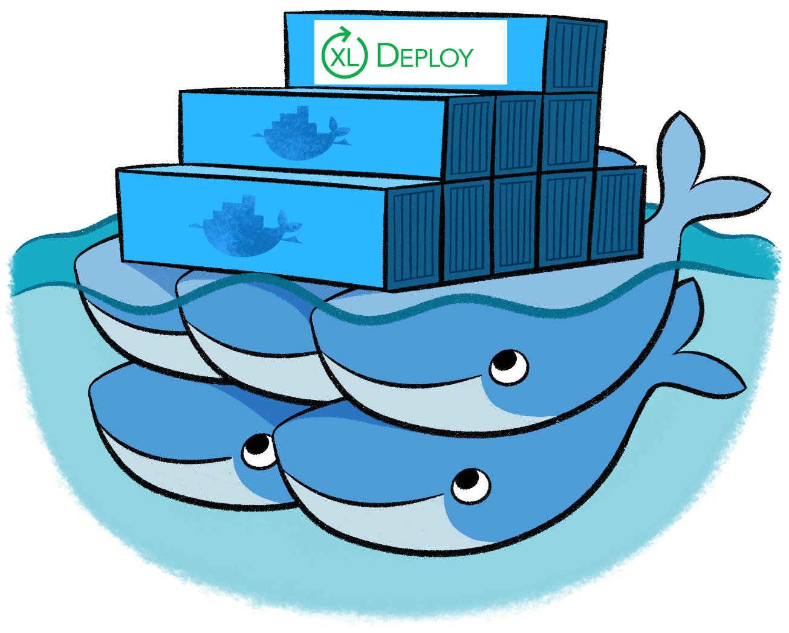
Можете выполнять задания

